Slide 1
Finding the Gradient
Year 9

Slide 2
Learning Intentions
Students will be able to
Calculate the gradient of a line between two coordinates

Slide 3
Think about it…..
When I mention the gradient, what do you think I mean?
The slope, m, used to describe the steepness of a line

Slide 4

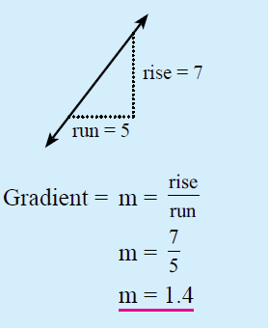
24
7
30
Topic: Gradient of a Line between two coordinates
Date:
EQ – What are the difference to just doing rise / run ?
What is the gradient?
It is the slope of a line. It measures the steepness of the line.

Slide 5
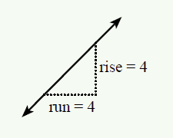
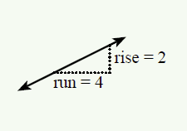
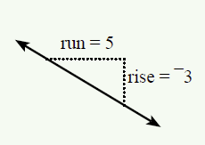
Practice
Notes:
Guide students through the question.
Option 2: Dot plots handout (Scaffolded for kids who may need extra help)

Slide 6


Slide 7
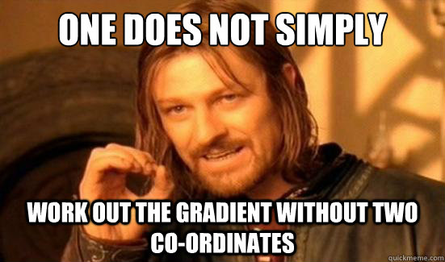

Slide 8
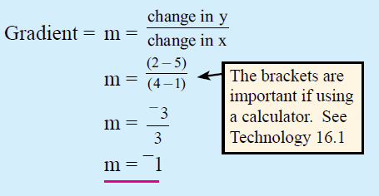
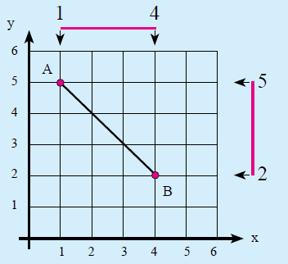
24
7
30
Topic: Gradient of a Line between two coordinates
Date:
EQ – What are the difference to just doing rise / run ?
Finding the gradient when given a pair of coordinates
Find the gradient between A(1,5) and B(4,2)

Slide 9
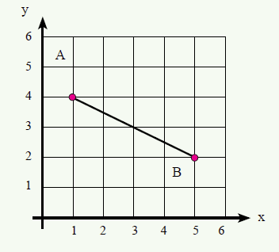
24
7
30
Topic: Gradient of a Line between two coordinates
Date:
EQ – What are the difference to just doing rise / run ?
Practice:
Find the gradient between A(1,4) and B(5,2)
Ex 16.7 pg 219 Q 2-13

Slide 10
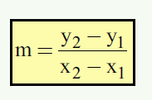
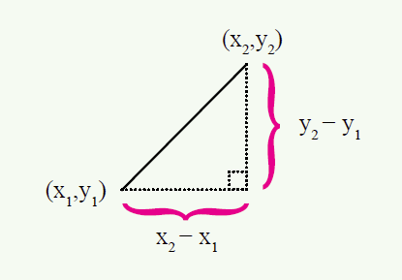
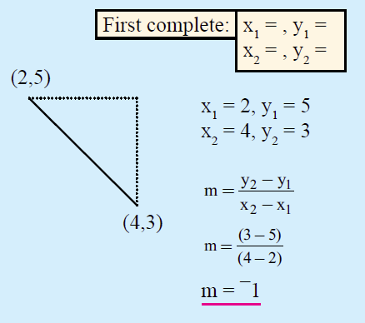
24
7
30
Topic: Gradient of a Line between two coordinates
Date:
EQ – What are the difference to just doing rise / run ?
Using a formula

